Slide 1
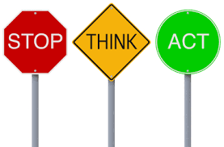
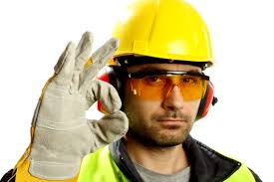
Safety
Year 7 PBL
Science, TAS, PDHPE

Slide 2
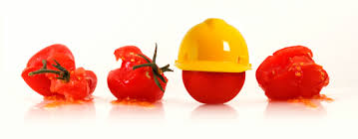
Introduction
Welcome to your first PBL task for the year.
This assessment is an introduction to subjects and content you will experience this term.
In TAS, Science and PHDPE classes you will have a strong focus on:
Safety and correct operational procedures during lessons

Slide 3
Safety
In PDHPE, Science and TAS look at a variety of ways to remain safe at school and in practical environments.
In this task you will be asked to create a survival guide/kit based on the Driving Question:
Why is Safety at NCAPAHS no accident?

Slide 4
Part two of the task is also GROUP work.
You describe how your team worked together on a Google doc and upload it to the allocated assessment folder (via class letter) within Google Classroom.

Slide 5
Process
Week 1 - Issued the assessment
3 lessons in total allocated to the task ( 1 from each faculty Science, TAS and PDHPE)
Weeks 2-3 - Independent work in your own time
Friday Week 4 – One team member to upload the digital resource and teamwork reflection to the Google classroom by 6PM
Week 5 - Complete reflection on the task/group dynamics.
You will be required to submit drafts of your work via Google classroom (this will help you practise for uploading the final task)
Early submissions will also be accepted

Slide 6
Drafting/Planning
It is important to produce drafts, revise and amend your ideas as you progress. In order to facilitate this, each group will be required to complete a draft of their task
Planning/Drafting: Wk 3
To be submitted to the Google classroom according to class number

Slide 7
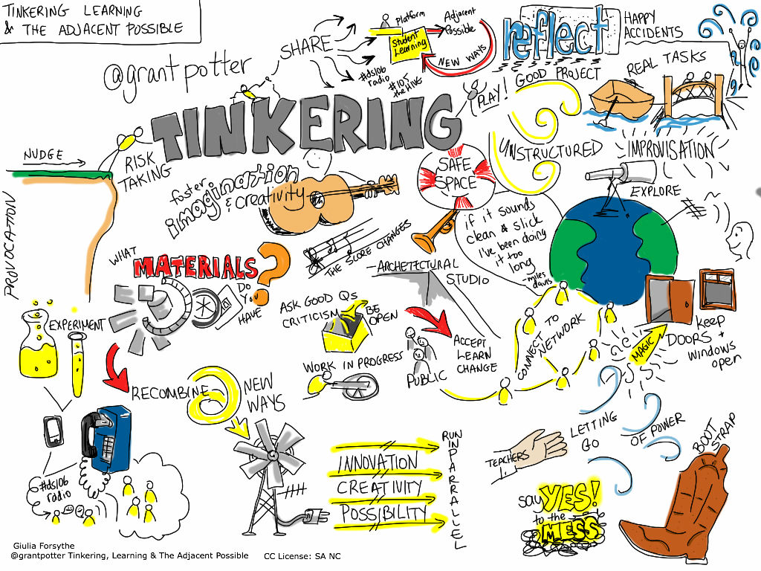

Slide 8
Google classroom
The assessment and resources can be found in the Year 7 PBL: Safety Google classroom
class code: 2crthq

Slide 9
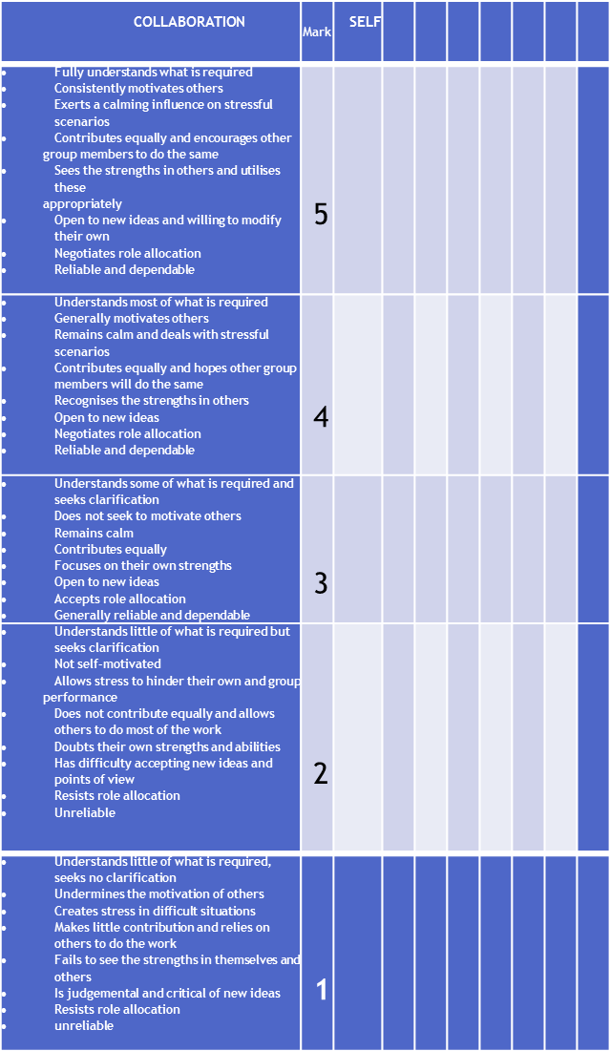
Collaboration Communication Time Management
You will be asked to reflect on the contributions that you and other group members have made
You need to honestly and maturely assess the group performance.
The reflection asks you to consider three key areas:

Slide 10
Remember this is a COLLABORATIVE TASK
You should work with each other, bounce ideas off each other and give and receive feedback.
Its not a task that you throw together the night before its due
Good luck =)

