Slide 1
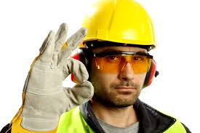
Safety
Year 7 PBL
Science, TAS, PDHPE

Slide 2
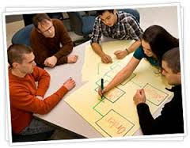
PBL
Escape traditional class projects
Learning is in YOUR hands (Student centred)
Investigate & respond to an authentic, engaging and complex question
YOU design plan and create
Cross-curricular
Both group and individual work

Slide 4
Teamwork and collaboration
Communication Participation Respect
Working cooperatively Contributing
Group decision making Responsibility

Slide 5
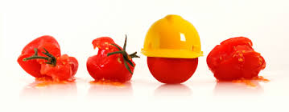
Introduction
Welcome to your first PBL task for the year.
This assessment is based on the introductions to subjects you have experienced so far this term.
In TAS, Science and PHDPE classes you have had a strong focus on:
Safety and correct operational procedures during lessons

Slide 6
Safety
In PDHPE, Science and TAS you have looked at a variety of ways to remain safe at school and in practical environments.
In this task you will be asked to create a digital resource based on the Driving Question:
How do we make Northmead classrooms safe environments?

Slide 7
Resource suggestions
Website
Movie/video
Glogster
Animation
PowerPoint
Prezi
Interactive worksheet with hyperlinks

Slide 8
Part two of the task is also GROUP work.
You describe how your team worked together on a Google doc and upload it to the allocated assessment folder (via class letter) within Google Classroom.

Slide 9
Process
Week 2 - Issued the assessment and RANDOMLY assigned groups of 4-5 in Science Classes
1 Science lessons allocated to the task
1-2 PDHPE and TAS lessons allocated to work on the task (each)
Weeks 2-5 - Independent work in your own time
Friday Week 5 – One team member to upload the digital resource and teamwork reflection to the Google classroom by 6PM
Week 5 - Complete reflection on the task/group dynamics.
You will be required to submit drafts of your work via Google classroom (this will help you practise for uploading the final task)
Early submissions will also be accepted

Slide 10
Drafting/Planning
It is important to produce drafts, revise and amend your ideas as you progress. In order to facilitate this, each group will be required to complete two drafts where the teacher will give feedback and discuss your progress
Planning/Drafting: wk 4
To be submitted to the Google classroom according to class number

Slide 11
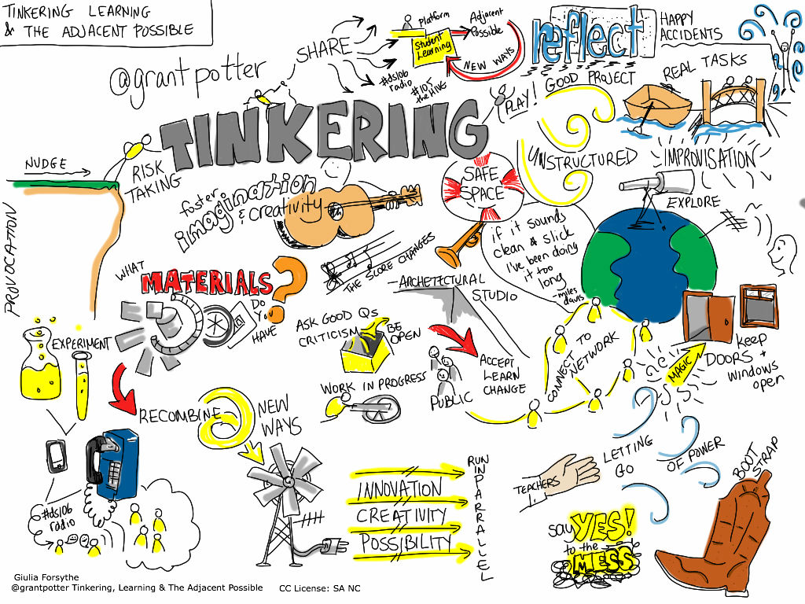

Slide 12
 | Wk 2 | Wk 3 | Wk 4 | Wk 5 (Friday)
SCIENCE | Groups assigned Issue Assignment |  | DRAFT DUE In G/C Feedback on draft
TAS |  |  | Feedback on draft
PDHPE |  |  | Feedback on draft
Independent work | Consider assessment Choose digital resource type | Own research | Own research | Own research
Submission of digital resource (group) and teamwork - Google doc (group)
Lesson allocation (can occur at any time):
SCIENCE – 1 Lesson
TAS/ PDHPE – 1 Lesson each

Slide 13
Google classroom
The assessment and resources can be found in the Year 7 PBL: Safety Google classroom
class code: hatbarp

Slide 14
Marking
Everyone will receive a group mark for their digital resource (part 1) and teamwork reflection (part 2)
Teachers will observe during lessons, look at self-reflections and group evaluations to help determine marks
In order to ensure that the marking is fair, students who do not participate effectively may have their mark reduced or awarded a zero.

Slide 15
Presentation and audience
Students who produce the best digital resource will be asked to share their product with members of the public.
Invitations will be extended to several groups and people, all involved in working with safety for you to present to.

Slide 16
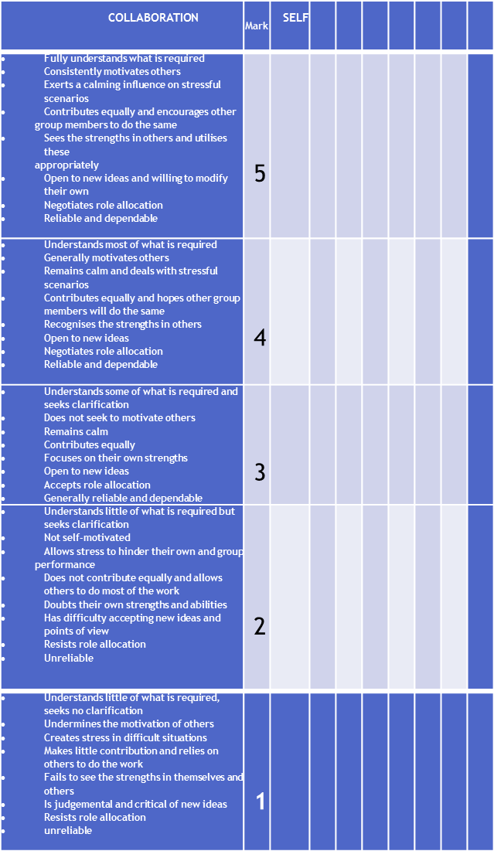
Collaboration Communication Time Management
You will be asked to reflect on the contributions that you and other group members have made
You need to honestly and maturely assess the group performance.
The reflection asks you to consider three key areas:

Slide 17
Remember this is a COLLABORATIVE TASK
You should work with each other, bounce ideas off each other and give and receive feedback.
Its not a task that you throw together the night before its due
Good luck =)

